Slide 1

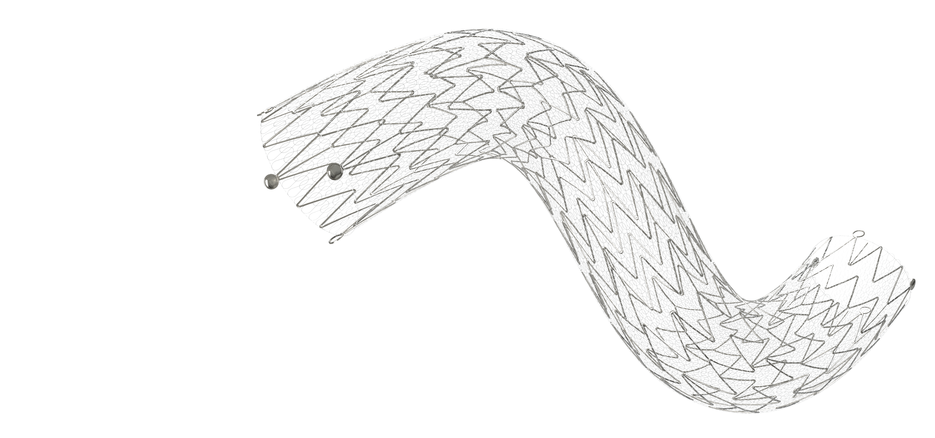

CGuard EPS Carotid Stent Platform for Sustained Embolic Protection
Nasdaq: NSPR

Slide 2
Disclaimers
Forward Looking Statement
This presentation contains "forward-looking statements." Such statements may be preceded by the words "intends," "may," "will," "plans," "expects," "anticipates," "projects," "predicts," "estimates," "aims," "believes," "hopes," "potential" or similar words. For example, the Company is using forward-looking statements when it discusses the potential commercialization and market opportunities for its products and product candidates, its cash runway, and its anticipated future milestone Company events. Forward-looking statements are not guarantees of future performance, are based on certain assumptions and are subject to various known and unknown risks and uncertainties, many of which are beyond the Company's control, and cannot be predicted or quantified and consequently, actual results may differ materially from those expressed or implied by such forward-looking statements. Such risks and uncertainties include, without limitation, risks and uncertainties associated with (i) market acceptance of our existing and new products, (ii) negative clinical trial results or lengthy product delays in key markets, (iii) an inability to secure regulatory approvals for the sale of our products, (iv) intense competition in the medical device industry from much larger, multinational companies, (v) product liability claims, (vi) product malfunctions, (vii) our limited manufacturing capabilities and reliance on subcontractors for assistance, (viii) insufficient or inadequate reimbursement by governmental and other third party payors for our products, (ix) our efforts to successfully obtain and maintain intellectual property protection covering our products, which may not be successful, (x) legislative or regulatory reform of the healthcare system in both the U.S. and foreign jurisdictions, (xi) our reliance on single suppliers for certain product components, (xii) the fact that we will need to raise additional capital to meet our business requirements in the future and that such capital raising may be costly, dilutive or difficult to obtain and (xiii) the fact that we conduct business in multiple foreign jurisdictions, exposing us to foreign currency exchange rate fluctuations, logistical and communications challenges, burdens and costs of compliance with foreign laws and political and economic instability in each jurisdiction. More detailed information about the Company and the risk factors that may affect the realization of forward- looking statements is set forth in the Company's filings with the Securities and Exchange Commission (SEC), including the Company's Annual Report on Form 10-K and its Quarterly Reports on Form 10-Q. Investors and security holders are urged to read these documents free of charge on the SEC's web site at http://www.sec.gov. The Company assumes no obligation to publicly update or revise its forward-looking statements as a result of new information, future events or otherwise.
This presentation shall not constitute an offer to sell or the solicitation of an offer to buy, nor shall there be any sale of these securities in any state or other jurisdiction in which such offer, solicitation or sale would be unlawful prior to registration or qualification under the securities laws of any such state or other jurisdiction.
2

Slide 3






Investment Highlights : Transformational Market Drivers
CGuard EPS Stent Platform Utilizing Proprietary MicroNet™ Technology
Highly differentiated platform for treatment of carotid artery disease and stroke prevention
CMS Approved Standard Risk and Asymptomatic Reimbursement
Enables stent-first approach to carotid revascularization
US IDE Trial Advancing toward US approval
FDA decision on approval of CGuard EPS anticipated in H1 2025
Unmatched Clinical Outcomes (both Short- and Long-Term)
CGuard™ EPS – (9) clinical trials completed >1,850 patients published and peer reviewed
Market Potential
Current treated market: $1.3 billion (Dx & Treated with CEA + CAS)
Total untreated market: $8 billion (Dx with HGCS not treated)
Deep Pipeline and Strategic Roadmap
MicroNet™ technology pipeline: SwitchGuard for TCAR; acute stroke with tandem lesions
Expanding Commercial Footprint
Double-digit market share in 30 served countries (34% in Italy)
Over 50,000 stents sold to date
Transformational May 2023 financing up to $113.6 million provides runway through potential US approval of CGuard Prime EPS and other value-creating milestones
Experienced management team and directors with extensive healthcare expertise

Slide 4
CMS Final National Coverage Determination, October 11, 2023
In summary, this final decision memorandum, which affects NCD 20.7 sections B4 and D, revises Medicare coverage for Percutaneous Transluminal Angioplasty (PTA) of the carotid arteries concurrent with stenting by:
1
Expanding coverage to individuals previously only eligible for coverage in clinical trials;
Expanding coverage to standard surgical risk individuals by removing the limitation of coverage to only high surgical risk individuals;
Adding formal shared decision-making with the individual prior to furnishing CAS; and
Allowing MAC discretion for all other coverage of PTA of the carotid artery concurrent with stenting not otherwise addressed in NCD 20.7.
2
3
4

Slide 5

Endovascular Procedures: Landscape and InspireMD Potential
CEREBRAL
ANEURYSMS
CORONARY
ARTERY DISEASE
THORACIC/ABDOMINAL
AORTIC ANEURYSMS
PERIPHERAL
ARTERIAL DISEASE
CAROTID ARTERY DISEASE⁵
AWAITING CONVERSION TO ENDO
30% Surgical¹
23% Surgical²
35% Surgical³
19% Surgical⁴
Surgical
Endo
77% Endo²
65% Endo³
81% Endo⁴
70% Endo¹
35%
Surgical / Other³
Already have been converted to endovascular procedures
CAD market potential
open to endo conversion Globally:
¹ Bekelis K, Gottlieb DJ, Su Y, et al. Comparison of clipping and coiling in elderly patients with unruptured cerebral aneurysms. J Neurosurg. 2017;126(3):811–818
² Culler SD, Kugelmass AD, Brown PP, , et al. Trends in Coronary Revascularization Procedures Among Medicare Beneficiaries Between 2008 and 2012. Circulation. 2015;131(4):362-70
³ Beck AW, Sedrakyan A, Mao J, et al. Variations in Abdominal Aortic Aneurysm Care: A Report From the International Consortium of Vascular Registries. Circulation. 2016;134(24):1948‐1958
⁴ Guez, D., Hansberry, D. R., Gonsalves, C. F., Eschelman, D. J., Parker, L., Rao, V. M., & Levin, D. C. Recent Trends in Endovascular and Surgical Treatment of Peripheral Arterial Disease in the Medicare Population. AJR Am J Roentgenol. 2020 May;214(5):962-966.
⁵ Procedures For Selected Nations, 2017 – 2025 presented to InspireMD, Inc. by Health Research International Personal Medical Systems, Inc. Sept. 13, 2021
Notes:
Last 4’ of Vascular System that is Surgical First

Slide 6
Potential Multi Billion Dollar Market Opportunity
MicroNetTM covered CGuardTM stent platform could become the new gold standard
WW carotid procedures today are
primarily surgical
Carotid procedures tomorrow could be mostly minimally invasive with CGuard™
Current Treated Global Market:
→ $1.3 billion
407K Global procedures (CEA/CAS/TCAR) to treat HGCS (High Grade Carotid Stenosis)
Current Treated U.S. Market:
→ $809 million
155K procedures to treat HGCS
Current Untreated Global Market:
→ $8 billion
~2.8 million people diagnosed with HGCS (Untreated)
Standard Risk and Asymptomatic reimbursement (US) increases CAS potential
(1)
1)
1. 2021 Health Research International Market Report; internal estimates
= InspireMD focus areas

Slide 7
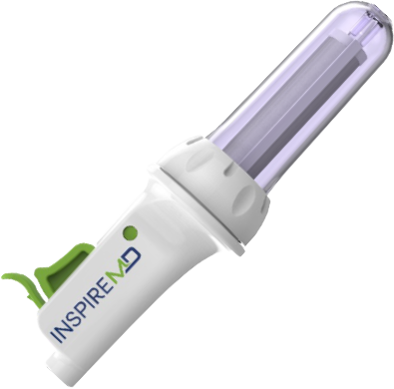
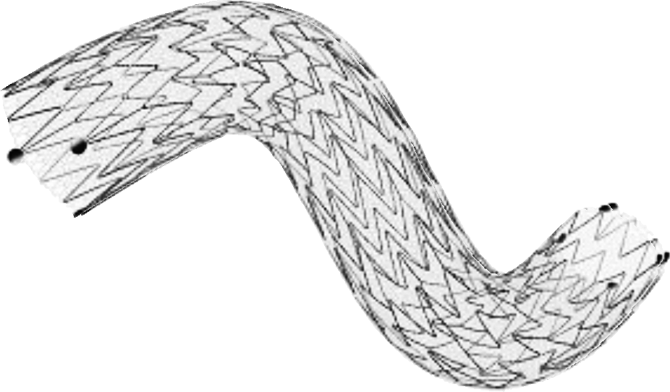
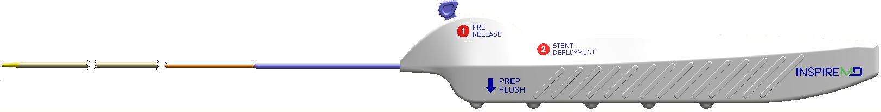
Long-Term Stent Performance is the Cornerstone of Our Focus
Delivery Platform Agnostic
CGuard EPS
Well-positioned to capitalize on the ongoing paradigm shift toward a “stent first” approach and away from surgery
Agnostic to stent delivery platform (TCAR vs. CAS)
CAS
TCAR
Tandem
Stroke

Slide 8
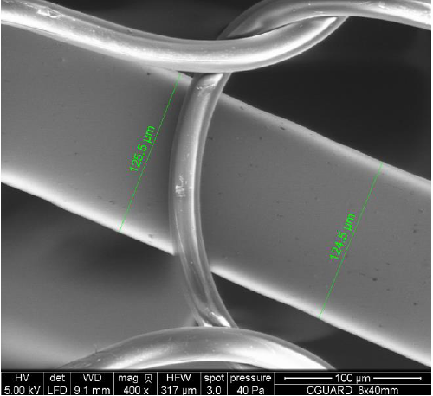
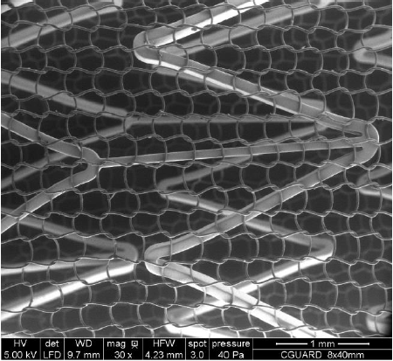
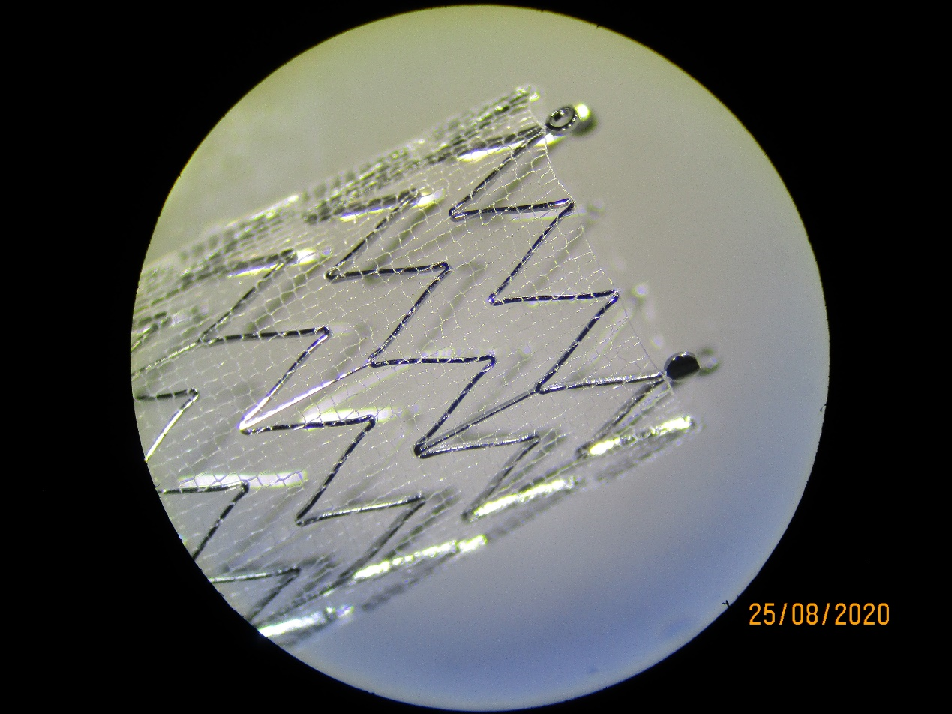

PROBLEM: Approximately 2/3 of neurovascular events (stroke, TIA) occur after the carotid surgery procedure takes place². How to preserve the flexibility of an open-celled stent while building in embolic protection?
OUR SOLUTION: The CGuard EPS
The only stent platform available with our patented MicroNet mesh technology
Interior Component:
Open-Cell Nitinol stent
(92 µm and 125 µm)
Exterior Component :
Closed-cell PET
(Polyethylene terephthalate)
25 µm
Cell size: 165 µm
1. Cano et al. Rev Bras Cardiol Invasiva 2013; 21(2): 159-64. 2. Bosiers et al. Eur J Vasc Endovasc Surg Vol 33, Feb 2007.,

Slide 9
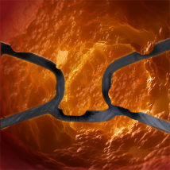
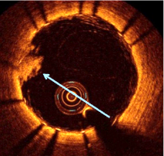
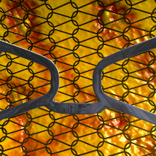
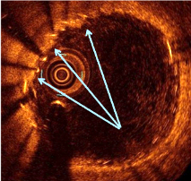
OUR SOLUTION: Proprietary MicroNetTM Technology¹
New mesh covered stent offers superior plaque coverage when compared to conventional stent approaches
VS.
Protruding
plaque/thrombus
between struts
MicroNetTM sealing plaque/
thrombus against vessel wall
Conventional Open Cell Stent (1St GEN):
Bare or dual layer approach, with plaque protrusion risk
CGuard Stent System (2nd GEN):
Stents are covered in MicroNet
An Embolic Prevention System (EPS) for Ultimate Thrombus Protection
MicroNet captures and locks thrombus & plaque materials against the arterial wall, deterring debris from entering the bloodstream while also acting as a mechanical barrier to prevent plaque protrusion
¹ Tomoyuki Umemoto, MD. Optical coherence tomography assessment of new generation mesh-covered stents after carotid stenting. Eurointerventional 2017;1348-1355 (published online)
Image: Prof. Valdés Chávarri
Image: Prof. Valdés Chávarri

Slide 10


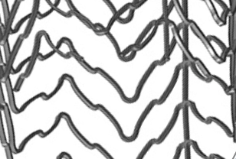
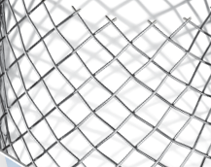
Pore Sizes
CGUARD™
CASPER®
*165µ
375µ
500µ
1050µ
1900µ
Closed cell stent
Open cell stent
ACCULINK™
WallStent™
* Bench test results may not necessarily be indicative of clinical performance.
Stent images approximately at scale but not exact
* Average in lesion at expanded state
Notes:
Pore size comparison which will be further discussed in the clinical data section

Slide 11
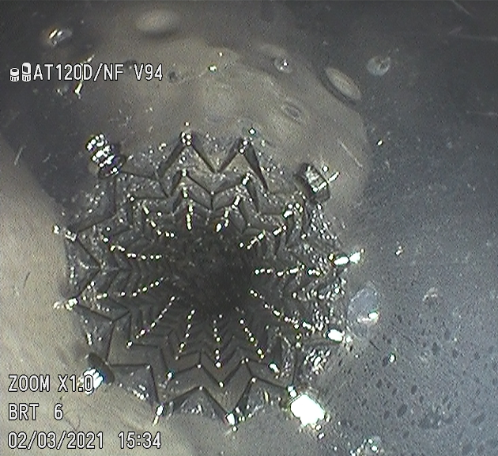
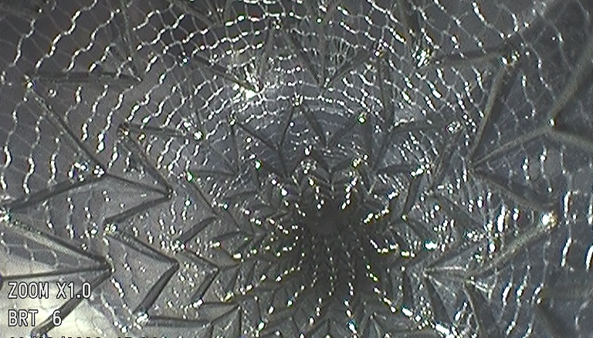
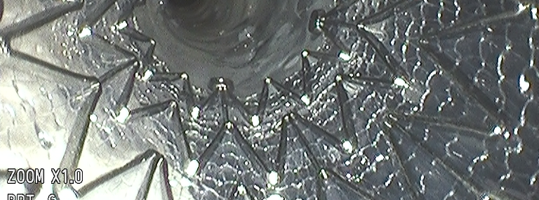

Slide 12
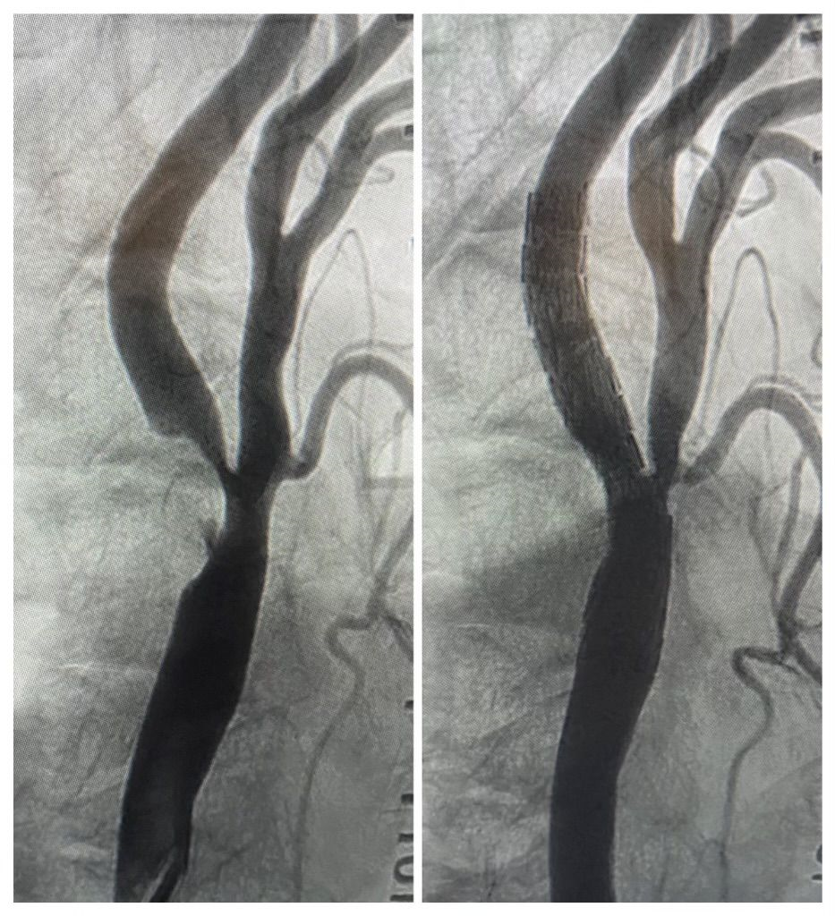
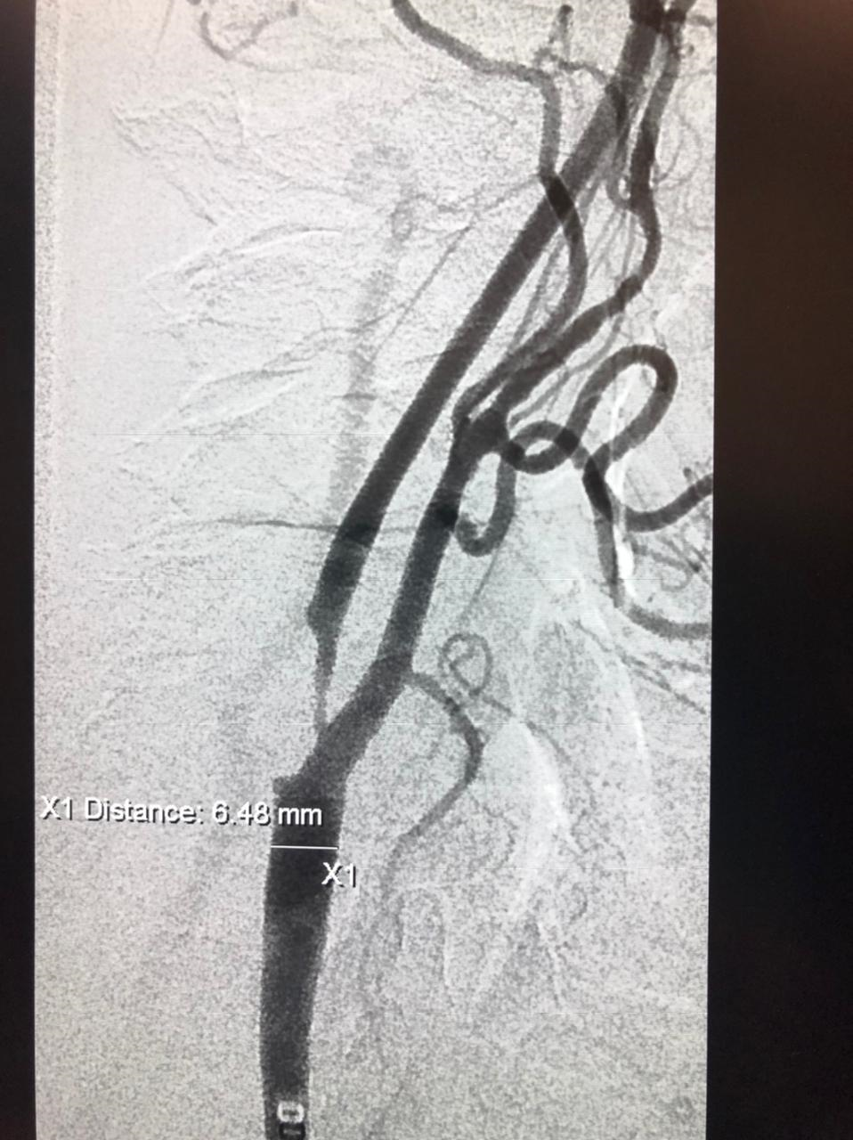
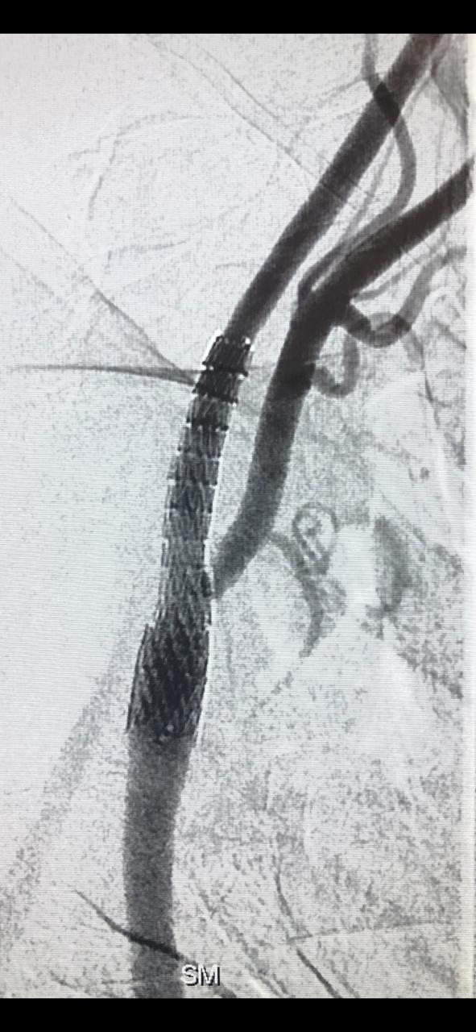
A picture is worth a thousand words …
90% occlusion
CGuard Stent
90% occlusion
CGuard Stent

Slide 13
Unmatched Superior Foundational Data

Slide 14
CGuard™ EPS Yields Superior Clinical Outcomes
When compared with Conventional Stents and Surgery (CEA), CGuard trends Superior
30 Day DSMI (Death, Stroke, Myocardial Infarction)
No stent related major stroke and 11 minor strokes to date with CGuard in 1,873 patients in 9 studies (0.6%)
CGuard is a next-generation stent supported by a strong clinical data
(10)
(10)
Improvement
(1-9)
CGuardTM
Conventional
Stents
Surgery
(CEA)
IRONGUARD I EuroIntervention 2018 Nov 20. 14:1150-1152. 2. IRONGUARD II, LINC 2020 3. CASANA Eur J Vasc Endovasc Surg 2017 Dec. 54:681-687. 4. WISSGOTT I J Endovasc Ther 2019 08. 26:578-582. 5. WISSGOTT II J Endovasc Ther 2017 02. 24:130-137. 6. PARADIGM Extend, EuroIntervention 2016 Aug 05. 12:e658-70. Updated LINC 2020. 7. CARENET JACC Cardiovasc Interv 2015 Aug 17. 8:1229-1234. 8. Randomize Clinical Trial EuroPCR e-Course, June 25, 2020. 9. Tigkiropoulos J Endovasc Therapy Volume 28 Issue 4, Aug 2021 10. CREST N Engl J of Med 2010 July 1. 11-23. * Calculated on Event Count

Slide 15
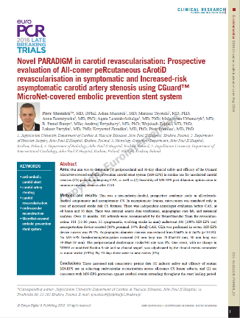
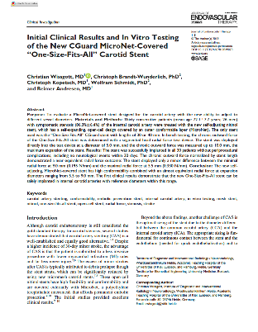
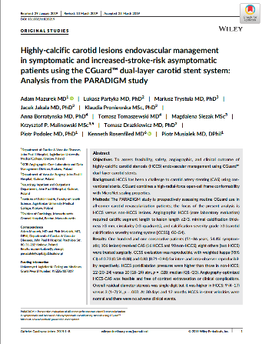
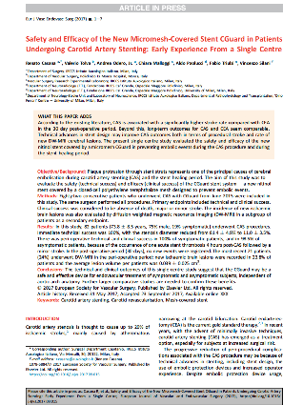
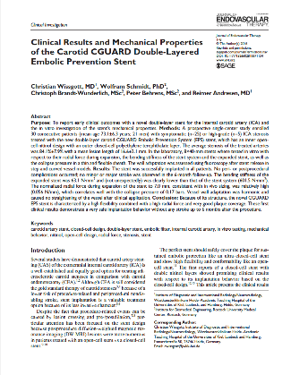
Carotid Solution: Our Well Studied Mesh-Covered Technology
More than
1,850
patients in Clinical Publications & Studies

Slide 16



Clinical Support Highlights
2015-2022
  PARADIGM + Extend
  Opened CARENET study inclusion criteria all comers.
  Concluded the safety and clinical outcomes were applicable to all.
  500 patients followed 5 years. Defines standard for measured sustained protection and long-term outcomes
  CARENET Trial
  First in Man Study- Demonstrated Safety, Efficacy, & Neuroprotection over other stents data
  Reduction of embolization
  (50% fewer lesions / 80% less volume with 0 events @ 30 days)
  Randomized Control Trial
  CGuard vs. Conventional Stent (Abbott Acculink)
  CGuard superiority in Randomized study format
  Confirms CARENET results with statistical significance

Slide 17
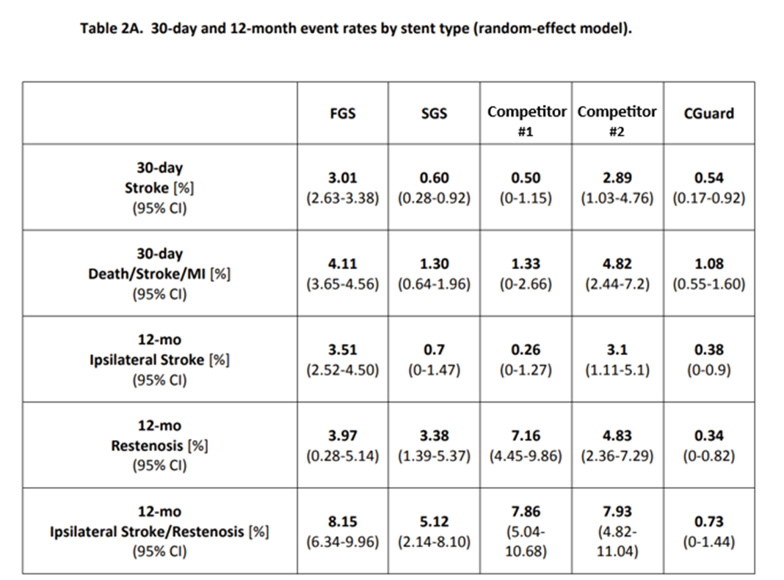
CARMEN Meta-Analysis (112 Studies, 68K Patients)
Improvements from second-generation stents (SGS) relative to first-generation stents (FGS), but important differences exist amongst the SGS:
CGuard’s MicroNet drives improvement both in event reduction (due to improved scaffolding) and restenosis reduction (due to less metal burden)
Clinical Outcomes of Second- versus First-Generation Carotid Stents: A Systematic Review and Meta-Analysis, J. Clin. Med. 2022, 11

Slide 18
US Regulatory Pathway

Slide 19
PMA Trial Design (CGuardians I)
FDA Trial Performance Goal – 11.6% vs European Clinical Trials’ Mean Performance 1.32% (w/ 1 Yr)
  Pivotal study objective evaluate the safety and efficacy of the CGuard™ Carotid Stent System in the treatment of carotid artery stenosis
    Intent to Treat Protocol
    Primary Endpoint: Symptomatic and asymptomatic patients undergoing carotid artery stenting (CAS) to a performance goal of <11.6% developed from published CAS literature. (Composite of DSMI through 30 days or ipsilateral stroke 31 - 365 days post-index procedure). Calculation will be the composite of the following: incidence of the following major adverse events: death (all‐ cause mortality), all stroke, and myocardial infarction (DSMI) through 30‐days post‐index procedure, based on the clinical events or ipsilateral stroke from 31‐365-day follow‐up, based on CEC adjudication.
    In European clinical studies, CGuard data of 1,485 patients followed for one year - 1.32%***
  Chris Metzger, M.D. (Ballad Health) : Principal Investigator
  316 Patients – Enrollment completed (23 months)
  25 Centers (20 in the United States and 5 in Europe)
  HCC (Hart Clinical Consultants) CRO specializing in Carotid trial execution
  Christina Brennan, M.D. and Gary Roubin, M.D.,PhD. : Supporting advisory experts
  *** 1. IRONGUARD I EuroIntervention 2018 Nov 20. 14:1150-1152 2. IRONGUARD II 1-Year Results From a Prospective Experience on CAS Using the CGuard Stent System JACC: Cardiovascular Interventions Vol. 14, No. 17, 2021. 3. Academic Data Registry PARADIGN-EXTENDED Monitored 30 days and 12 Months Outcomes Report, Oct 24, 2022 (Prospective evaluation of All-comer percutaneous carotid revascularisation in symptomatic and increased risk asymptomatic carotid artery stenosis using CGuard MicroNet –covered embolic prevention stent system) 4. 5 Year Clinical Ultrasound Outcomes in CARENET Prospective Multicenter Trial of CGuard MicroNET Covered Stent JACC: Cardiovascular Interventions Vol. 15, No. 18, 2022 September 26, 2022:1183-1891
* 2021 Health Research International Market Report; internal estimates

Slide 20
C-Guardians: 30-day Major Adverse Events
Results presented at VEITH - 2023
Event rate in % (n) | ITT (N=316) | Per Protocol^
Death, Stroke or MI* | 0.95% (3) | 0.63% (2)
Death# | 0.32% (1) | 0.% (0)
Any stroke# | 0.95% (3) | 0.63% (2)
Major Stroke# | 0.32% (1) | 0.0 % (0)
Minor Stroke# | 0.63% (2) | 0.62% (2)
MI# | 0.0% (0) | 0.0% (0)
Death or any stroke* | 0.95% (3) | 0.63% (2)
Death or major stroke* | 0.32% (1) | 0.0% (0)
* Hierarchical: patient count (each patient first occurrence of the most serious event).
# Non-hierarchical: event count (multiple events in each patient are counted individually).
^ Per Protocol Analysis excludes 1 patient (did not take dual antiplatelet therapy; had a major stroke and died).
CGuard Stent system is investigational only and not for sale in the USA.

Slide 21
TCAR

Slide 22
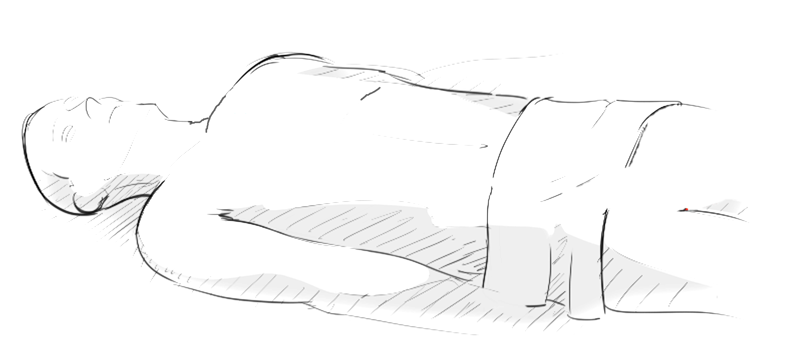
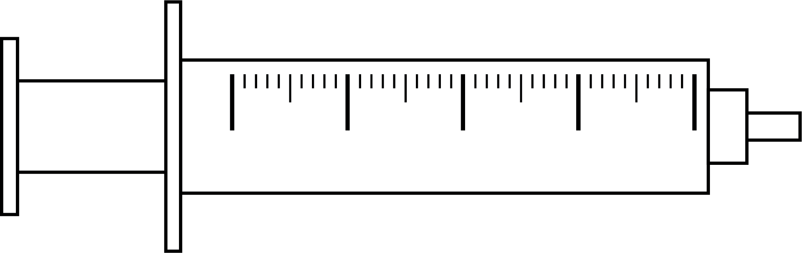
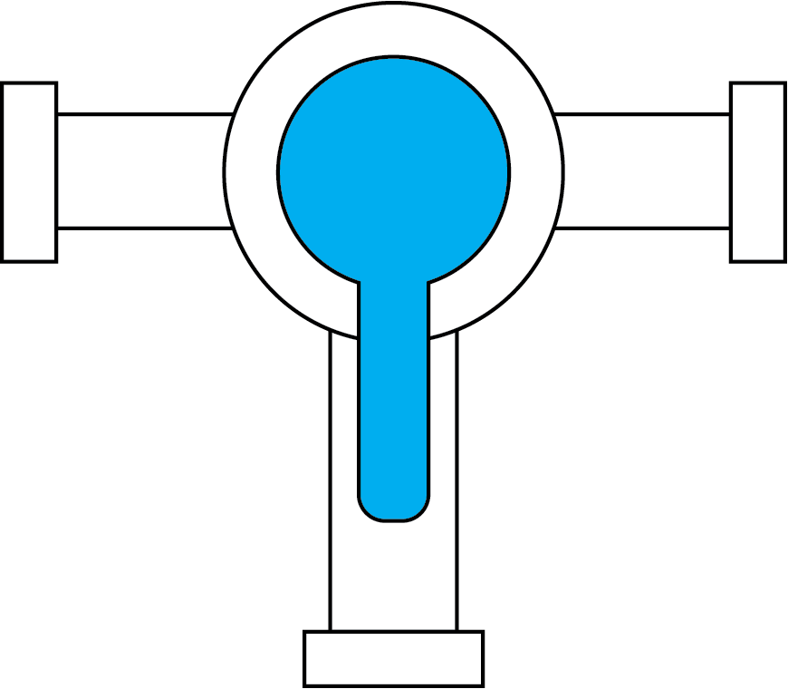






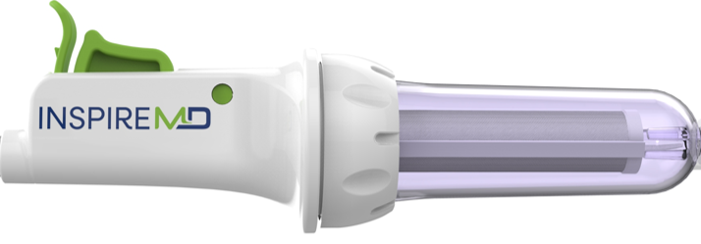
TCAR Procedure: Reverse Flow
Contrast port
Guidewire
(1)
Clamping (ligation)
80CM
Stent
Aspiration port
Stent pull back device
(1)
SwitchGuard NPS serves Trans carotid (TCAR) Opportunity with Best-in-Class CGuard Implant
1. Transient flow reversal combined with sustained embolic prevention in transcervical revascularization of symptomatic and highly-emboligenic carotid stenoses for optimized endovascular lumen reconstruction and improved peri- and post-procedural outcomes, Advances in Interventional Cardiology 2020;16, 4 (62):495-506

Slide 23
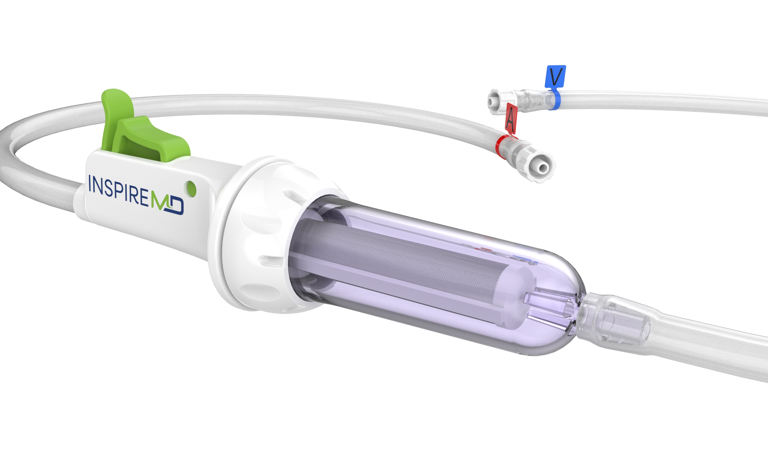
SwitchGuard NPS (TCAR)
TCAR Market Opportunity
>2,600 TCAR-trained physicians in the U.S.¹
>24,000 TCAR procedures ($170M) projected in the U.S. in 2023, strong double-digit growth projected^{1,2}
InspireMD’s C-GUARDIANS II TCAR trial anticipated to commence
mid-2024; Potential clearance in H2 2025
80CM
¹ SILK reporting
² Piper-Sandler model, 11/8/23

Slide 24
Roadmap + Milestones

Slide 25
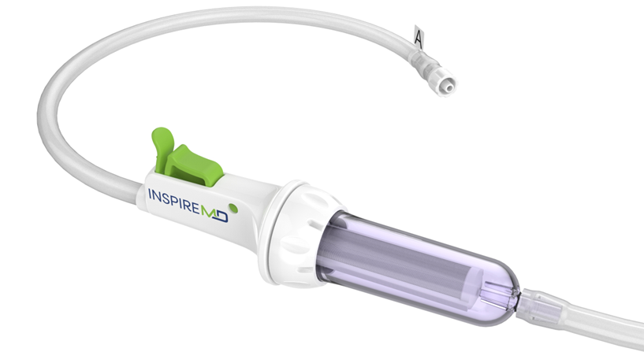
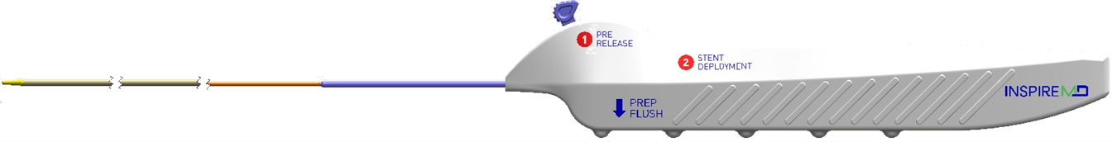

Our Advancement Roadmap / Milestones
Our Expected Key Value Drivers and Strategic Pathways
FDA PMA Submission (Module II, III and IV)
Initiation of C-GUARDIANS II (TCAR) study
Acute Stroke EFS- Tandem Lesions
China Regulatory Submission
CGuard Prime CE Mark
CGuard Prime PMA Approval for CAS and TCAR
U.S. Commercial Launch
Build out of U.S. HQ and Production
SwitchGuard NPS Approval + Launch
Scale US Operations
Approval China
2026
2025
2024

Slide 26
Corporate

Slide 27









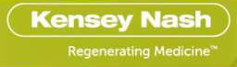




Our Board of Directors
Marvin L. Slosman President and CEO | Mr. Slosman has over 30 years of experience in the medical device industry with focused leadership in commercialization and international market development in both public and privately held companies. He has had senior management roles in a variety of public and privately held companies.
Paul Stuka Chairman | Mr. Stuka was named to the Board of Directors in August of 2011 and serves as Chairman of the Board of Directors. Mr. Stuka is a Managing Member of Osiris Partners and a 30-year investment industry veteran.
Michael Berman Director | Mr. Berman is a successful entrepreneur within the medical device industry. He joined Scimed in 1986, leading its marketing activities until its merger with Boston Scientific in 1995. From 1995-2000, he served as President of Boston Scientific/Scimed. Venture partner in RiverVest Ventures
Thomas Kester Director | Mr. Kester is CFO of Kester Search Group, Inc., a private executive search firm specializing in sales force placement for medical, dental and diagnostic device companies. He spent 28 years at KPMG LLP.
Gary Roubin, M.D.,Ph.D. Director | Dr. Roubin was named to the board of Directors in October 2020. Dr. Roubin has co-authored more than 280 clinical publications and has contributed to 20 textbooks in the fields of Interventional Cardiology and Vascular Surgery. He was a key contributor in the CREST trial which has validated the use of carotid stents for the treatment of carotid artery stenosis.
Katie Arnold Director | Ms. Arnold was named to the Board of Directors in May 2021. Ms. Arnold founded and leads SPRIG Consulting, providing the entire spectrum of strategic marketing services to medical companies. Ms. Arnold is currently an adjunct professor at Northwestern University’s Kellogg School of Business, where she teaches medical product commercialization and financing.
David Bonita, MD Board Observer | Dr. Bonita is a General Partner of OrbiMed. Prior to joining OrbiMed, he worked in the healthcare investment banking groups of Morgan Stanley and UBS. Dr. Bonita received his A.B. magna cum laude in Biological Sciences from Harvard University and his joint M.D./M.B.A. from Columbia University where he was elected to the Alpha Omega Alpha Medical Honor Society and Beta Gamma Sigma Business Honor Society.

Slide 28
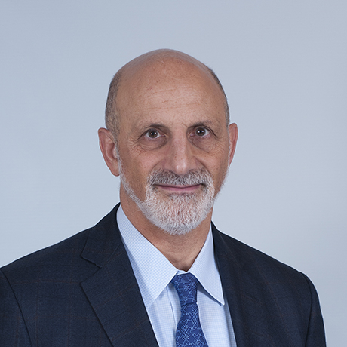
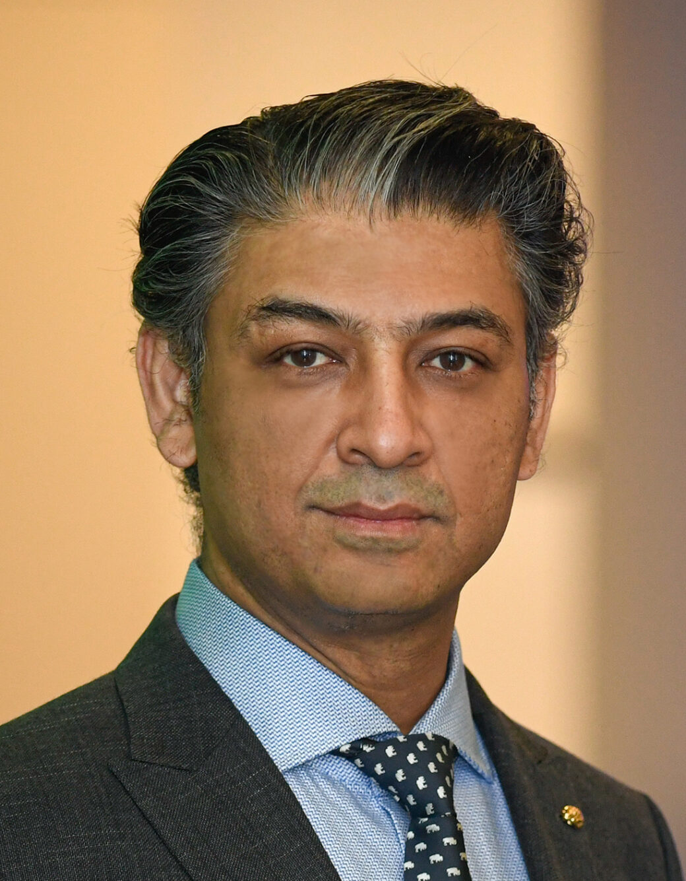
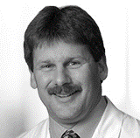
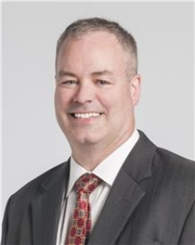



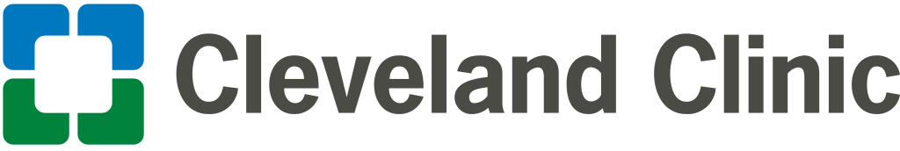
Scientific Advisory Board (Multidisciplinary KOLs)
Kenneth Rosenfield, M.D.
Interventional
Cardiologist
Adnan H. Siddiqui, M.D. Ph.D
Professor, Vice Chairman of the Department of Neurosurgery
Chris Metzger , M.D.
Medical Director
Cardiologist
Sean Lyden, M.D.
Vascular Surgeon

Slide 29
Commercial Footprint
Active selling in more than 30 countries
Over 45,000 systems sold
Average CAS Market share of 25%
Signed agreement with Chinese distributor. Working toward distribution
U.S. Market Investigation Device Exemption (IDE) approval September 2020; US trial initiated Q3 2021
Exploring expansion opportunities Taiwan, Japan, and Korea
Current Markets
Registration Work Underway

Slide 30
Our Robust Intellectual Property Portfolio
Proprietary platform technology supported by IP
Patent Rights | Issued | Pending
USA | 19 | 6
Rest of World | 40 | 17
InspireMD will continue to strengthen and broaden its patent protection globally to enable future pipeline products
IP Counsel: Kligler and Associates, P.A.

Slide 31





Transformational May 2023 Financing Up To $113.6 Million
To advance the company towards potential US approval and launch of CGuard EPS and other value-creating milestones
$42.2 million upfront funding
$71.4 million tied to the achievement of four milestones ($17.9 million each) each expiring upon the earlier of 5 years or 20 trading days following the achievement of the following milestones:
  Release of primary and secondary end points related to one year follow up study results from the C-Guardians pivotal trial;
  Receipt of Premarket Approval (PMA) from the FDA for the CGuard Prime Carotid Stent System (135 cm);
  Receipt of FDA approval for the SwitchGuard trans carotid system and CGuard Prime 80 cm; and
  Completion of four quarters of commercial sales of the CGuard in the United States.
Strong validation from leading fundamental healthcare investors, with additional participation by select NSPR Board members.

Slide 32
Summary Financials
March 19, 2024
NASDAQ Capital Markets | NSPR
Stock Price | $2.31
Average 3 Month Volume | 29.0K
Shares Outstanding | 23.4M
Shares Outstanding with Prefunded Warrants | 38.7M
Market Capitalization with Prefunded Warrants | $89.3M
Cash Balance - Dec. 31, 2023 | $39.0M
Debt | $0M

Slide 33

Nasdaq: NSPR

